Slide 1
Validating user input

Slide 2
Summary of the previous lecture
Super Global variables
Passing form data
Passing data with sessions

Slide 3
Outline
Regular expressions in PHP
Validating user input at server
String functions

Slide 4
1. Regular expressions in PHP
A regular expression is a concise notation to describe patterns in strings
Regular expressions provide the foundation for describing or matching data according to defined syntax rules
Example: |^[0-9]{2}-[0-9]{2}-[0-9]{4}$|

Slide 5
1. Regular expressions in PHP…
|^[0-9]{2}-[0-9]{2}-[0-9]{4}$|
Sub pattern with fixed character
Start and end of RE
Sub pattern
Sub pattern
Sub pattern
Start matching from the start
Match the end of the string
[0-9]
{2}
Allowed characters
length

Slide 6
1. Regular expressions in PHP…
Start and end of the RE:
optional, ||
Sub-patterns:
range of allowed characters
Allowed length
Sub-patterns with fixed character:

Slide 7
1. Regular expressions in PHP…
Matching from the start:
1212-12-2014
Matching till end:
12-12-2014123
For exact match we should use both ^ and $
Pattern exists if do not match from start
Pattern exists if do not match till end

Slide 8
1.1 Notations for RE
^: match strings that start with the given pattern
$: match strings that end with the given pattern
-: means a range of characters
[ ]: makes a class of characters
[^ ]: negates the class of character

Slide 9
1.1 Notation for RE…
Quantifiers:
{n}: matches a character, class or sub-pattern for n times
{ n, m}: matches a character, class or sub-pattern for minimum n times and maximum m times

Slide 10
1.1 Notation for RE…
?: matches the character, class or sub-pattern 0 or 1 time
equal to {0,1}
+: matches the character, class or sub-pattern 1 or more times
equals to {1, }
*: matches the character, class or sub-pattern 0 or any number of time
equals {0, }

Slide 11
1.1 Notation for RE…
Predefined character ranges:
\d: means exactly as [0-9]
\D: means exactly as [^0-9]
\w: means exactly as [a-zA-Z0-9]

Slide 12
1.1 Notation for RE…
RE examples:
Validating date:
|^\d{2}-\d{2}-\d{4}$|
Validating CNIC:
|^\d{5}-\d{7}-\d{1}$|
Validating Email:
|^[a-zA-Z0-9_.]+@[a-z]{3,5}.[a-z]{2,3}$|

Slide 13
1.1 Notation for RE…
Validating name:
|^[a-zA-Z ]{5,25}$|
Validating Password:
must contain ‘@’
|@|

Slide 14
2. Validating user’s input
preg_match():
searches a string for a specific pattern
returns TRUE if it exists and FALSE otherwise
preg_match(“pattern”,$string);

Slide 15
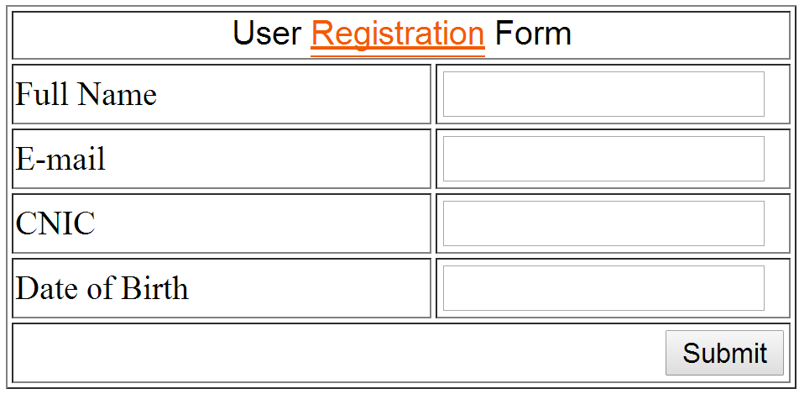
2. Validating user’s input
Post, action.php
name
email
cnic
dob

Slide 16
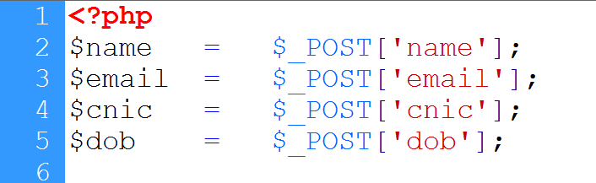
2. Validating user’s input
Receiving values
Validating name

Slide 17
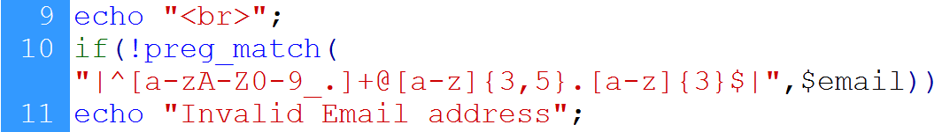
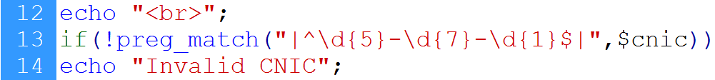
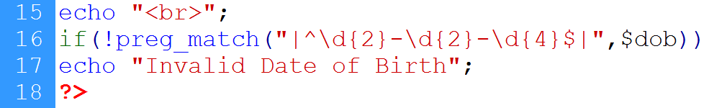
2. Validating user’s input
email
CNIC
DoB

Slide 18
3. String functions in PHP
strlen():
Returns the length of the string
strlen($string);
strcmp():
Compares two strings
Returns 0 if strings are equal, 1 if first string is greater and -1 if second is greater
strcmp($string1,$string2);
Strcasecmp():
Compares two strings in case insensitive manner
strcasecmp($string1,$string2);

Slide 19
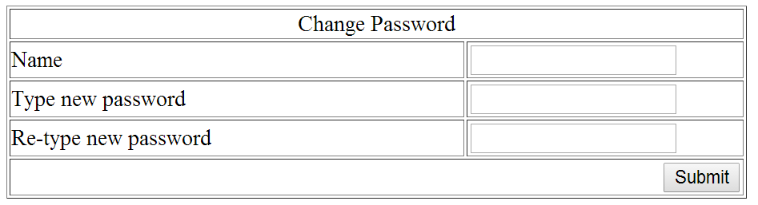
3. String functions in PHP…
Method=post
name
pass
pass1

Slide 20
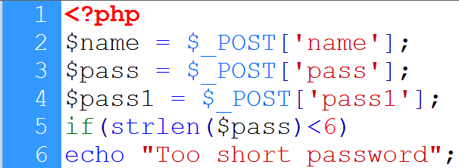
3. String functions in PHP…
Getting variables
Using strlen()

Slide 21
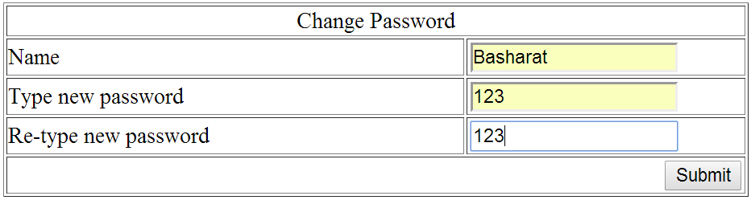

3. String functions in PHP…
Password is short

Slide 22

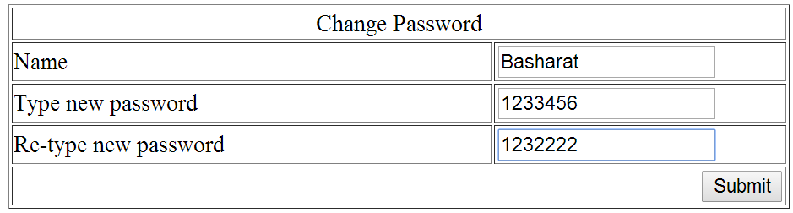

3. String functions in PHP…
Compares pass and pass1

Slide 23
3. String functions in PHP…
strtolower():
Convert a string in lower case
strtolower($string);
strtoupper():
Convert a string in upper case
strtoupper($string);
ucfirst():
Convert the first character of a string to upper case
ucfirst($string);
ucwords():
Convert the first character of each word in a string to upper case
ucfirst($string);

Slide 24
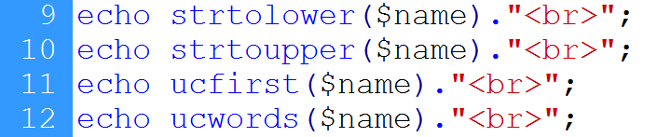
3. String functions in PHP…
Converts name to lowercase
Converts name to uppercase
Using ucfirst()
Using ucwords()

Slide 25
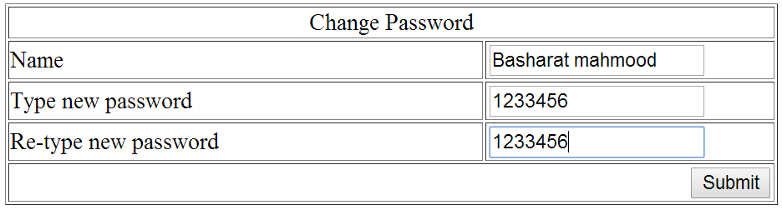
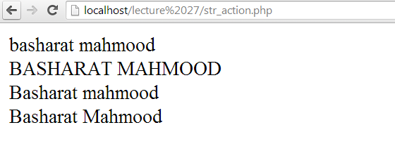
3. String functions in PHP…
Lowercase
uppercase
ucfirst()
ucwords()

Slide 26
3. String functions in PHP…
strpos():
finds the position of the first case-sensitive occurrence of a substring in a string
strpos($string,sub-string);
strrpos():
finds the position of the last case-sensitive occurrence of a substring in a string
strrpos($string,sub-string);
substr_count():
returns the number of times one string occurs within another
substr_count($string,sub-string);

Slide 27
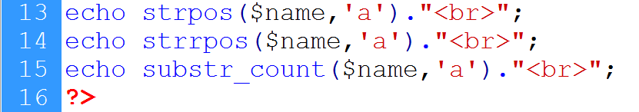
3. String functions in PHP…
Finding first occurrence of ‘a’
Last occurrence of ‘a’
Finding number of occurrences of ‘a’

Slide 28
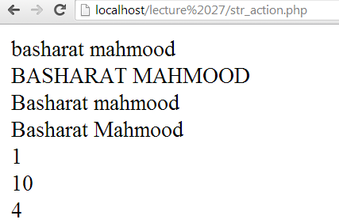
3. String functions in PHP…
First occurrence of ‘a’
Last occurrence of ‘a’
Number of occurrences of ‘a’

Slide 29
Summary
Writing regular expression in PHP
Validating user’s input
String functions

Slide 30
References
Chapter 9, “Beginning PHP and MySQL” by W. Jason Gilmore, Apress publisher, 4th edition; 2010, ISBN-13 (electronic): 978-1-4302-3115-8.

